Slide 1
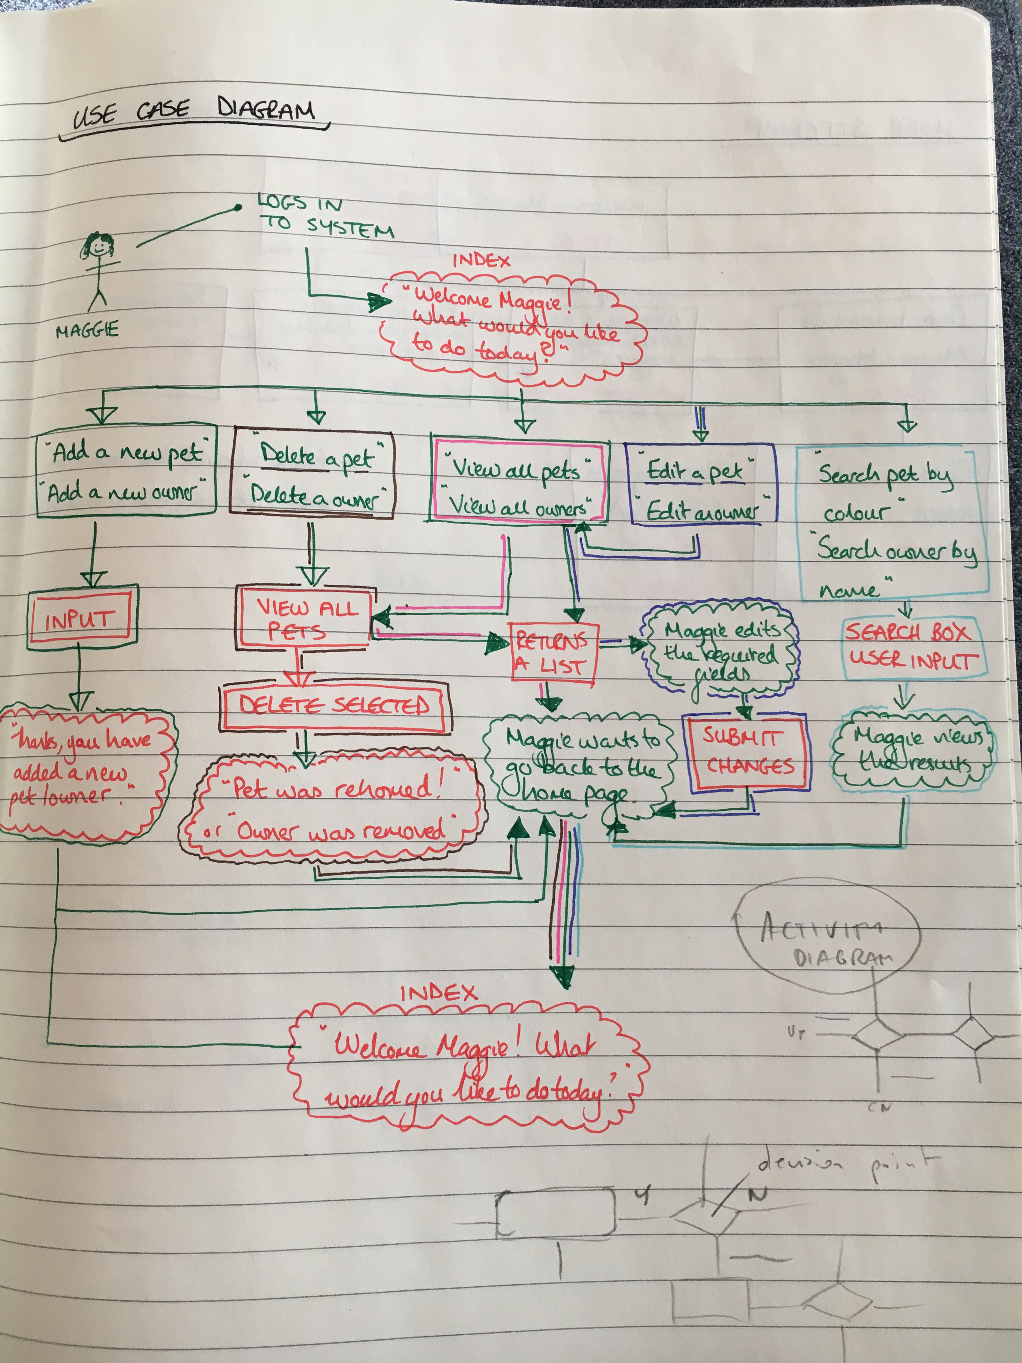
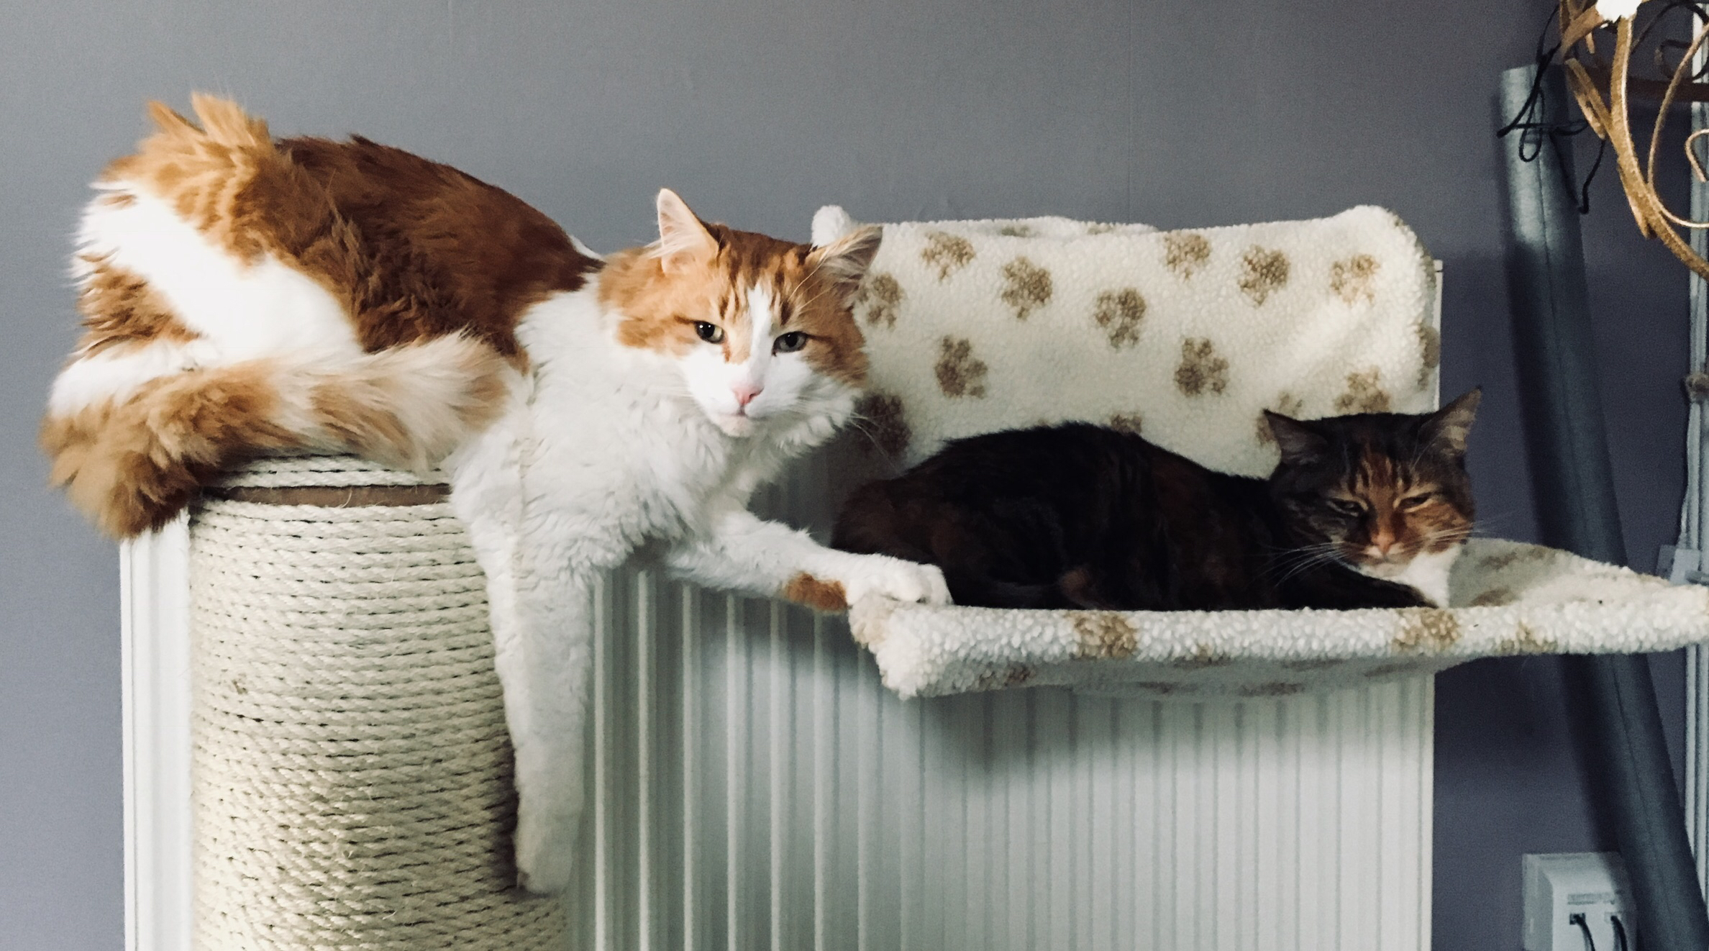
Project Week: Cat Shelter
Or is it…!
>.<
Because cats…yay! <3
Rachael Ellen, E20, Codeclan

Slide 2

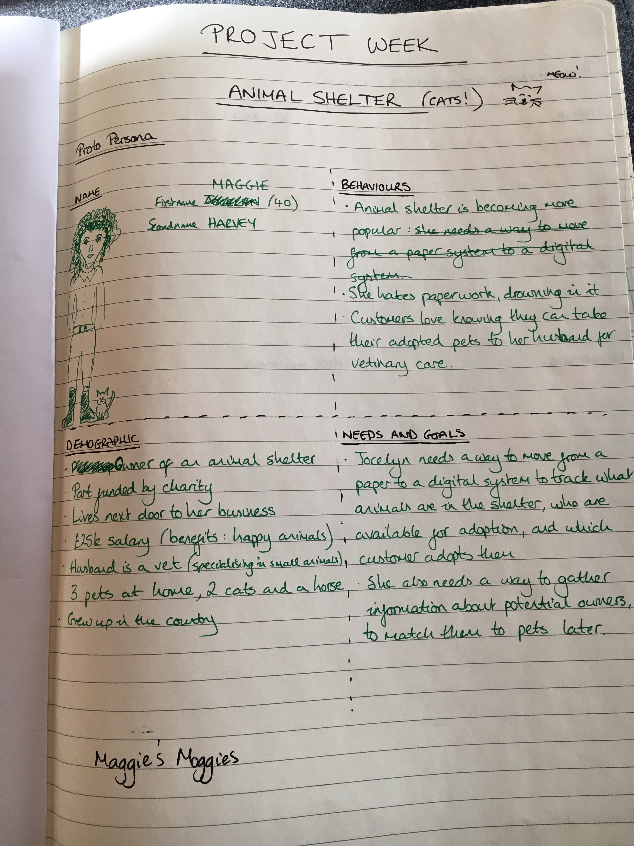
Project Journey
Weekend and Monday: user group (thanks Mum and Dad) and UX experience
Eureka moment…made me realise it’s for a management system!
As a… | I want to… | So that…
Cat shelter owner with an expanding business based on paper records, | Move from a paper based filing system to a digital database system | I can be more organised with tracking animals and potential owners, and not worry about losing data due to my horse eating the papers through the window.
Business owner with ambition to grow my business and allow accessibility for potential , | Have an online pets’ profile which would allow owners to search for meaningful information on potential pets | I have a larger customer base to rehome more of my adorable and delightful homeless cats.
Partner to my husband who is a small animal vet who wants to link his business with mine, | Include his business with my own by offering vet services to my customers | My customers know they can come to him for pet health advice, that I can still keep in touch with the pets, and so that my husband and I can expand our empire.
Person who loves animals and wants the best for them, | Have a system where I can collect as much information about a new owner as possible | So that I can pair them with their best pet match or suggest they should get a hamster if they’re not willing to cat worship.

Slide 3
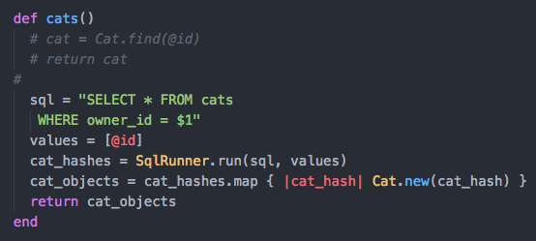
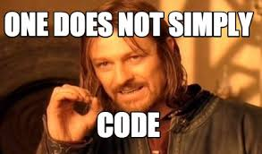
I couldn’t work this out… which id belongs to which class? Got there in the end.

Slide 4
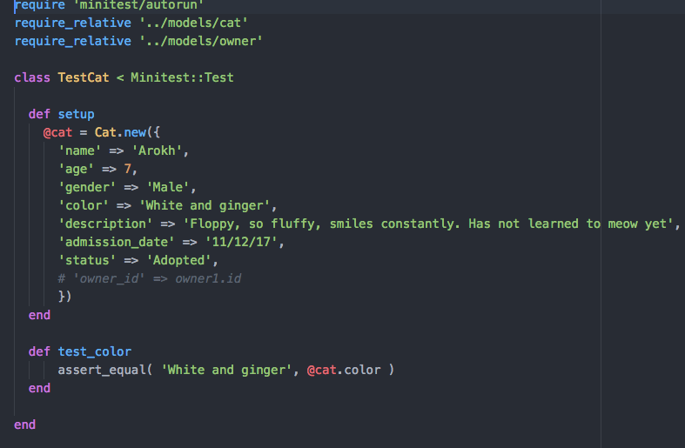

The token specs file… pretty pointless!

Slide 5
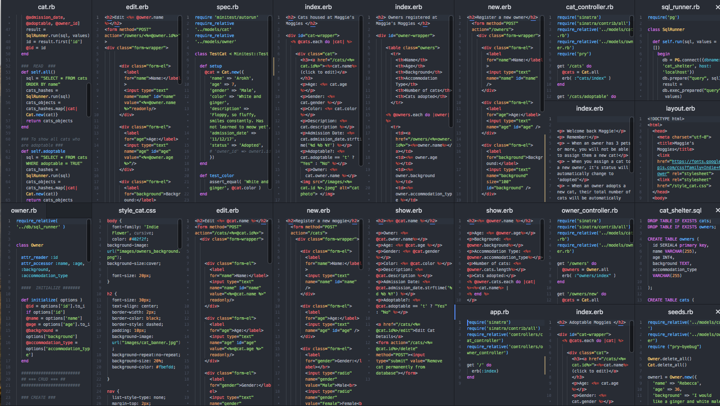
After a handful of database errors… and a truck tonne of Sinatra errors…
We have lift off! Let’s take a look. By the way, there’s 21 files of code sitting behind this kitty pad.

Slide 6
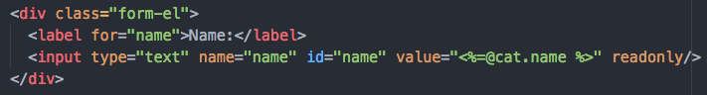
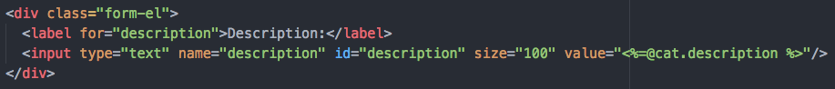
Some tricks I learned along the way
Read-only boxes
Description box length

Slide 7
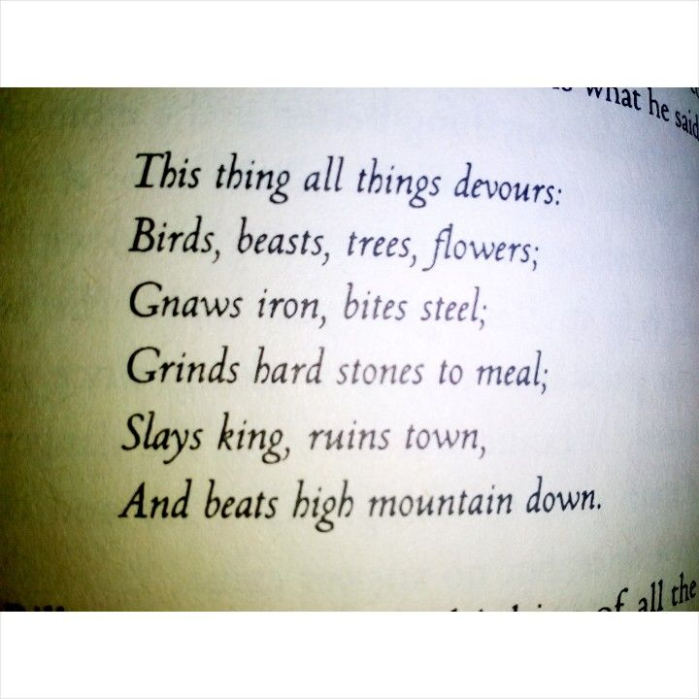


=
Time…
Flex the navigation bar
Make neater and more playful buttons
Add photo to page when adding a new cat
Currently Maggie can’t adopt a new cat (she has more than 3): would need to make another logic statement to address this.

Slide 8
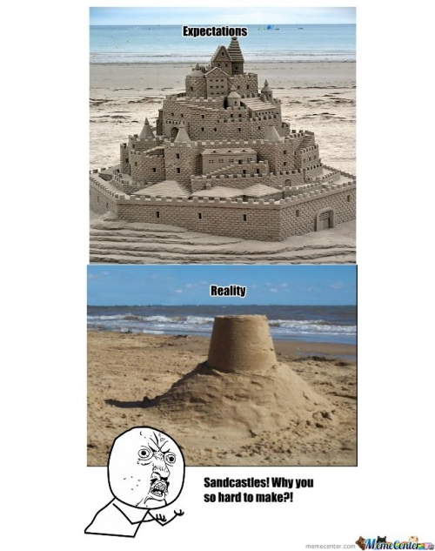
Achieved a lot in 5 weeks ☺
Thank you so much to Pawel, Keith and Sandy (and Sian!) for getting us through til now
Thank you so much all my awesome E20-ers, your support has been amazing <3

